Slide 1
Potentiometer
3 = +5V
4 = AI0+
5 = GND, AI0-
Motor 1
6 = GND, AI1-
7 = AI1+
Motor 2
1 = OUTA driver board
2 = OUTB driver board
Power Supply
12V 0.55A

Slide 2
motors
1 motor is the tacho.
1 motor is to drive the rotation

Slide 3
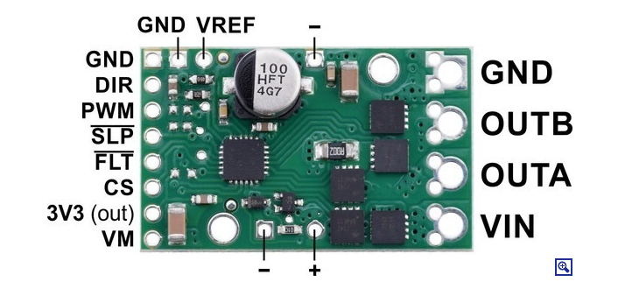
Need to tie this
High to enable the driver
I care about the 3 pins highlighted in red
I should put a big capacitor across this

Slide 4
12V 0.55A moves the motor when not connected to the motor driver board
PWM output from the myRIO registers on the scope.
5v output from the myRIO registers on the scope.
12v from the power supply to the bard (shows up on the scope).
Tied the SLP Pin High to activate the board (shown on scope).
Wierdly getting a 5v PWM out of the driver board. Also, with no power to VIN from the powr
Supply we are getting a 5V PWM out of the motor connection pins stuff, suggesting a short somewhere.

Slide 5
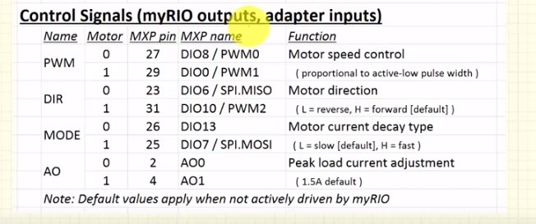
Diligent myrio adaptor
MXP just works. No messing around

Slide 6
9 sub pinout
M0+ (motor drive board)
2. GND (C)
3. AI 1+ (C)
4. AI 1- (C)
5. AI 0+ (C)
6. M0- (Motor drive board)
7. +5V (C)
8. Not connected
9. AI 0- (C)
orange
Green/yellow
purple
1-5
Motor 1
Motor 2
6-9
Green/yellow
No connection
Next steps: turn the square wave generated into PWM for output on DO (Convert into a duty cycle and a direction)

